Slide 1
Mentor Matching Project Pitch
By: Andrew Hahn, Hannah Hazelwood, Manjila Singh, Gregory Nothnagel

Slide 2
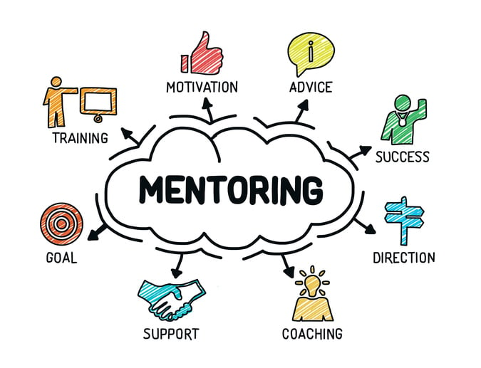

General Motivation
Creation of this project will provide the necessary framework for a freshmen mentorship program in the CS department
Facilitate meetings between faculty and freshmen and house mentor/mentee information
Provide support for freshmen in the department
  Professional Development
  Academic Development
  College Transition

Slide 3


Users
Faculty in the Computer Science Department
  Utilize service to access their list of mentees, view form responses and see current meetings/meeting history
Freshmen in the Computer Science Department
  Use service to find their mentor, find information about their mentor, and schedule mentor meetings

Slide 4
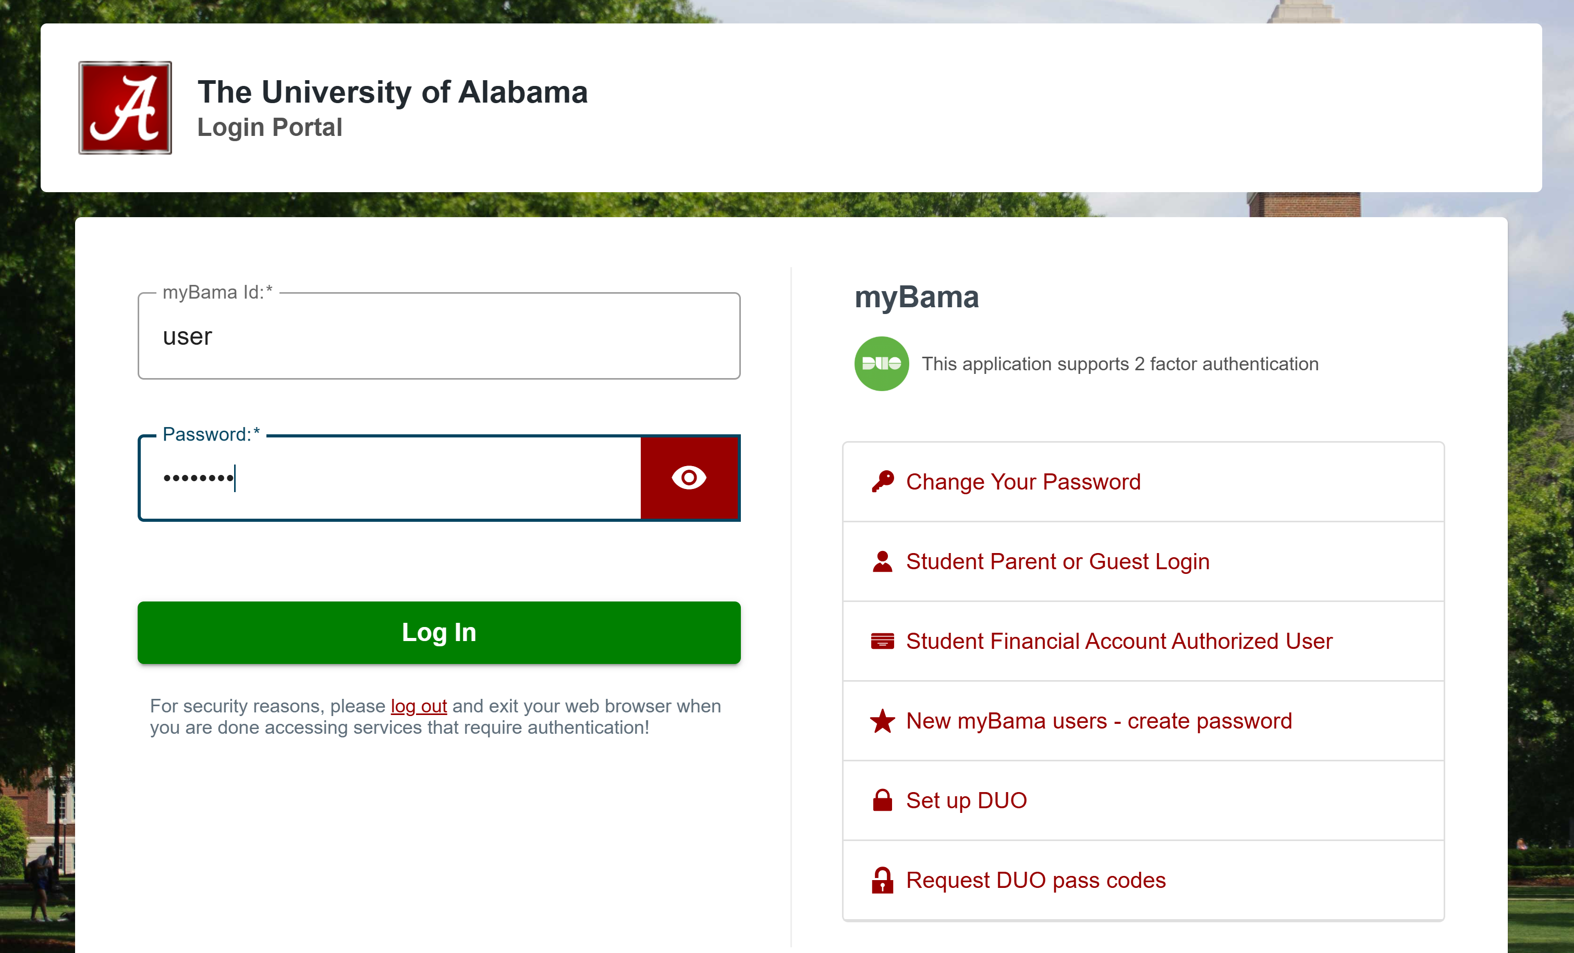

Core Features
Login System
  Login for mentors and students
  Secure authentication for user data protection
Interest-Based Mentor-Mentee Matching
  Students looking for a mentor fill out an interest form
  Automated algorithm that matches students with mentors based on availability and subject expertise

Slide 5



Email notifications
  Inform mentors about new mentees
  Notify students about their assigned mentors
Meeting Scheduling
  Integrated calendar for students to book time slots with mentors
Data Management
  Centralized database to store mentor-mentee assignments, student profiles, mentor availability, meeting history and more

Slide 6
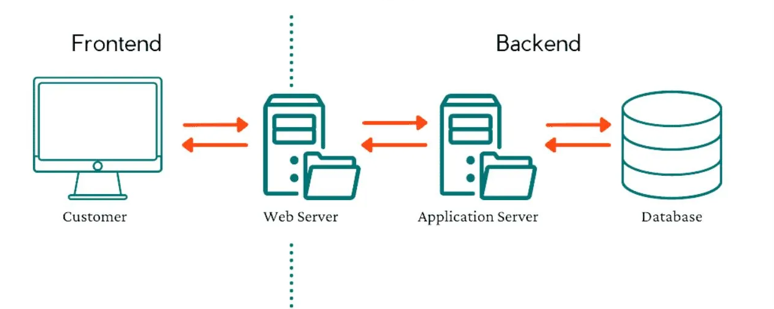
Technical Details
Format
  Frontend/Backend/Database
Technologies
  Database API
  Matching Algorithm
  Hosting Server

Slide 7


Environment
Frontend
  Framework – React.js
  Authentication – Firebase or similar library
Backend
  Framework - Django (Python)
  Database API – REST
Database
  Framework - PostgreSQL

Slide 8



Related Apps
mentorcliQ
  Gale-Shepley algorithm
  Suggested vs. self matching
Qooper
  Flash mentoring
LinkedIn
  Boolean / filtered search

Slide 9



Challenges
Freshmen preferences evolving (Dynamic constraint satisfaction)
Modifying the Gale-Shepley algorithm
  fairness, many-one relationships
Balancing:
  Mentor workload and student needs
  Ease of use and development time
  Functionality and maintainability

